Slide 1
ECON3510 – Tutorial 1
You won a free ticket to see an Eric Clapton concert (which has no resale value). Bob Dylan is performing on the same night and is your next-best alternative activity. Tickets to see Dylan cost $40. On any given day, you would be willing to pay up to $50 to see Dylan. Assume there are no other costs of seeing either performer. Based on this information, what is the opportunity cost of seeing Eric Clapton?
(a) $0
(b) $10
(c) $40
(d) $50
Nicholas Umashev

Slide 2
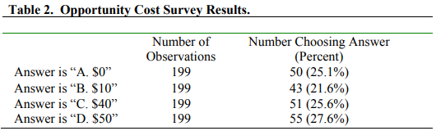
Question 1
Answer is (b) $10

Slide 3
Exercise 1 Comparative Advantage Trivia

Slide 4
Question 1
What is the relationship between opportunity cost and comparative advantage?
Notes:
Comparative advantage is when a country produces a good or service for a lower opportunity cost than other countries. Opportunity cost measures a trade-off. A nation with a comparative advantage in a good finds the trade-off favouring producing the good.

Slide 5
Question 2
Why do oil producing countries have a comparative advantage in chemicals?
Notes:
Oil-producing nations have a comparative advantage in chemicals because their locally-produced oil provides a cheap source of material for the chemicals when compared to countries without it. A lot of the raw ingredients are produced in the oil distillery process. As a result, Saudi Arabia, Kuwait, and Mexico are competitive with U.S. chemical production firms. Their chemicals are inexpensive, making their opportunity cost low.

Slide 6
Question 3
Why are many call centers located in India?
Notes:
USA, UK and Australia companies buy services from call centers in India because it is cheaper than locating the call centers in their countries. Indian call centers aren't necessarily better than U.S. call centers. Their workers don't always speak English in a way that is clear to local customers. But they provide the service cheaply enough to make the tradeoff worth it.

Slide 7
Question 1
In the past, comparative advantages occurred more in goods and rarely in services, but this is changing. Why?
Notes:
In the past, comparative advantages occurred more in goods and rarely in services. That's because products are easier to export. But telecommunication technology like the internet is making services easier to export. Those services include call centers, banking, and entertainment.

Slide 8
Exercise 2 Production Possibility Frontiers

Slide 9
Question 1
Table of Unit Labor Requirements
 | Computers | Education | Labor Hour Units
China | 1 | 20 | 400
Australia | 4 | 3 | 12
Write down the equation and draw the PPF of China and Australia?
What is the marginal product of labor in computers and education in China and Australia?
What is the opportunity cost of computers and education in China and Australia?
Which country has an absolute advantage in computers and which on education?
Which country has a comparative advantage in computers and which on education?
What are the slopes of the PPF of China and Australia?
Notes:
1) China: Q_{C}+20Q_{E}=400. Australia: 4Q_{C}+13Q_{E}=12. Let us put computers on the horizontal axis. Then, horizontal axis intercepts China is 400, the vertical intercept is 20. The horizontal axis intercepts Australia is 3, the vertical intercept is 4.
2) MPL in computer is 1 in China and ¼ in Australia. MPL education is 1/20 in China and 1/3 in Australia.
3) The opportunity cost of computers is 1/20 in China and 4/3 in Australia. The opportunity cost of education is 20 in china and ¾ in Australia.
4) China has an absolute advantage in computers, Australia in Education.
5) China has a comparative advantage in computers, Australia in Education.
6) With computers on the horizontal axis, the slope with the horizontal axis of the PPF is the opportunity cost of computers. The slope with the vertical axis of the PPF is the opportunity cost of education.

Slide 10
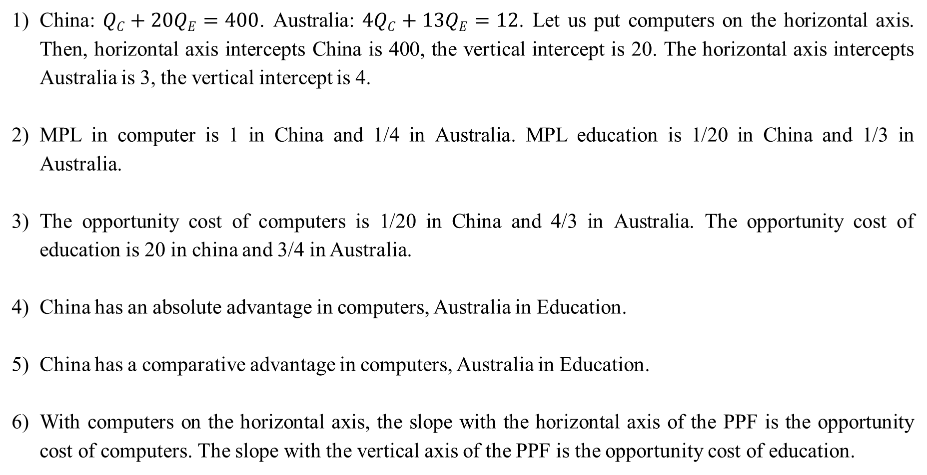
Question 1 - Answers
China: $QC+20QE=400$. Australia: $4QC+13QE=12$. Let us put computers on the horizontal axis. Then, horizontal axis intercepts China is 400, the vertical intercept is 20. The horizontal axis intercepts Australia is 3, the vertical intercept is 4.
MPL in computer is 1 in China and 1/4 in Australia. MPL education is 1/20 in China and 1/3 in Australia.
The opportunity cost of computers is 1/20 in China and 4/3 in Australia. The opportunity cost of education is 20 in china and 3/4 in Australia.
China has an absolute advantage in computers, Australia in Education.
China has a comparative advantage in computers, Australia in Education.
With computers on the horizontal axis, the slope with the horizontal axis of the PPF is the opportunity cost of computers. The slope with the vertical axis of the PPF is the opportunity cost of education.

Slide 11
Exercise 3 Relative Trade and Marginal Substitution

Slide 12
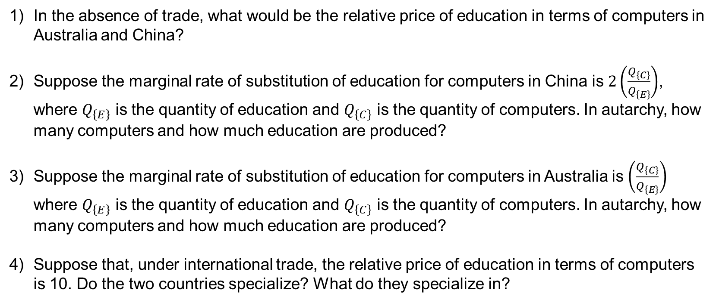
Question 2
Table of Unit Labor Requirements
 | Computers | Education | Labor Hour Units
China | 1 | 20 | 400
Australia | 5 | 10 | 12
In the absence of trade, what would be the relative price of education in terms of computers in Australia and China?
Suppose the marginal rate of substitution of education for computers in China is $2\left(\frac{Q_{\left\{C\right\}}}{Q_{\left\{E\right\}}}\right)$, where $Q_{\left\{E\right\}}$ is the quantity of education and $Q_{\left\{C\right\}}$ is the quantity of computers. In autarchy, how many computers and how much education are produced?
Suppose the marginal rate of substitution of education for computers in Australia is $\left(\frac{Q_{\left\{C\right\}}}{Q_{\left\{E\right\}}}\right)$ where $Q_{\left\{E\right\}}$ is the quantity of education and $Q_{\left\{C\right\}}$ is the quantity of computers. In autarchy, how many computers and how much education are produced?
Suppose that, under international trade, the relative price of education in terms of computers is 10. Do the two countries specialize? What do they specialize in?
Notes:
1) For China: P_{E}/P_{C}=20/1=20. For Australia: P_{E}/P_{C}=10/5=2.
2) It must be P_{E}/P_{C}=20= 2Q_{C}/Q_{E} or Q_{C}=10Q_{E} and Q_{C}+20Q_{E}=400. Hence Q_{E}=40/3 and Q_{C}=400/3.
3) It must be P_{E}/P_{C}=2=Q_{C}/Q_{E} or Q_{C}=2Q_{E} and 5Q_{C}+10Q_{E}=10. Hence Q_{E}=3/5 and Q_{C}=6/5.
4) Yes they specialize. Australia in education, China in computers.

Slide 13
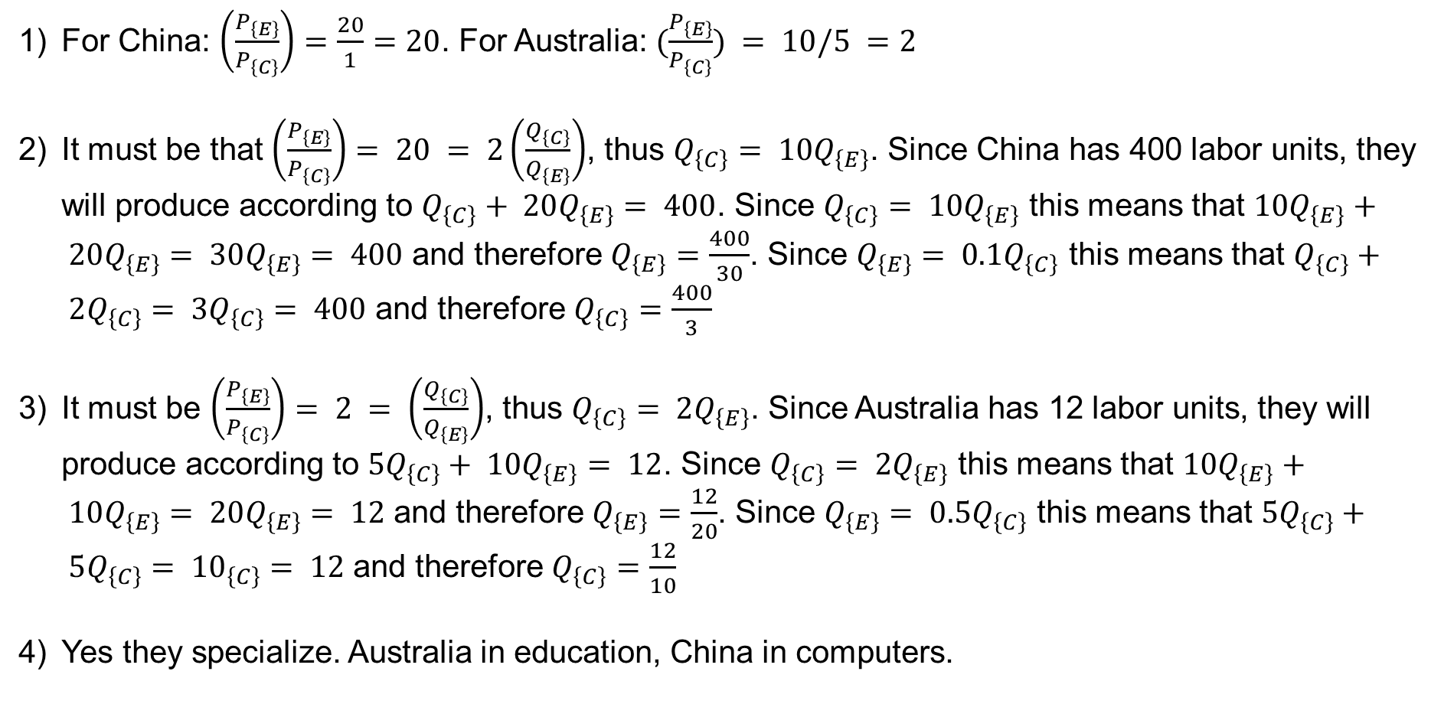
Question 2 - Answers
For China: $\left(\frac{P_{\left\{E\right\}}}{P_{\left\{C\right\}}}\right)=\frac{20}{1}=20$. For Australia: $(\frac{P_{\left\{E\right\}}}{P_{\left\{C\right\}}}) = 10/5 =2$
It must be that $\left(\frac{P_{\left\{E\right\}}}{P_{\left\{C\right\}}}\right)= 20 = 2\left(\frac{Q_{\left\{C\right\}}}{Q_{\left\{E\right\}}}\right)$, thus $Q_{\left\{C\right\}}= 10Q_{\left\{E\right\}}$. Since China has 400 labor units, they will produce according to $Q_{\left\{C\right\}}+ 20Q_{\left\{E\right\}}= 400$. Since $Q_{\left\{C\right\}}= 10Q_{\left\{E\right\}}$ this means that $10Q_{\left\{E\right\}}+ 20Q_{\left\{E\right\}}= 30Q_{\left\{E\right\}}= 400$ and therefore $Q_{\left\{E\right\}}=\frac{400}{30}$. Since $Q_{\left\{E\right\}}= 0.1Q_{\left\{C\right\}}$ this means that $Q_{\left\{C\right\}}+ 2Q_{\left\{C\right\}}= 3Q_{\left\{C\right\}}= 400$ and therefore $Q_{\left\{C\right\}}=\frac{400}{3}$
It must be $\left(\frac{P_{\left\{E\right\}}}{P_{\left\{C\right\}}}\right)= 2 = \left(\frac{Q_{\left\{C\right\}}}{Q_{\left\{E\right\}}}\right)$, thus $Q_{\left\{C\right\}}= 2Q_{\left\{E\right\}}$. Since Australia has 12 labor units, they will produce according to $5Q_{\left\{C\right\}}+ 10Q_{\left\{E\right\}}= 12$. Since $Q_{\left\{C\right\}}= 2Q_{\left\{E\right\}}$ this means that $10Q_{\left\{E\right\}}+ 10Q_{\left\{E\right\}}= 20Q_{\left\{E\right\}}= 12$ and therefore $Q_{\left\{E\right\}}=\frac{12}{20}$. Since $Q_{\left\{E\right\}}= 0.5Q_{\left\{C\right\}}$ this means that $5Q_{\left\{C\right\}}+ 5Q_{\left\{C\right\}}= {10}_{\left\{C\right\}}= 12$ and therefore $Q_{\left\{C\right\}}=\frac{12}{10}$
Yes they specialize. Australia in education, China in computers.
Notes:
Discussion time

